Slide 1
Introducing R
Intro to R Workshop
Trainers –
Helpers –

Slide 2
Today’s Objective(s) – What we hope you will get out of today
Introduction to R
The basics of R – data objects
Data plotting
How to find more information for a specific task
The start of the journey, a network of R learners/users around you.
Entry into more advanced and specialised uses of R for your research.

Slide 3
Why R? (as opposed to Excel?)
It’s free, legally free. Active development.
Reproducible analysis.
Document what you have done with your data in code.
Come back to it in days, months, years and you should know what was done.
Low risk of inadvertent data loss/mutation.
By design, R requires you to load your data in, what you do with the data is then written in code (R language).
R can handle really large datasets.
Excel is limited by 1,048,576 rows and 16,384 columns.
Collaborative.
Share your data and analysis.

Slide 4
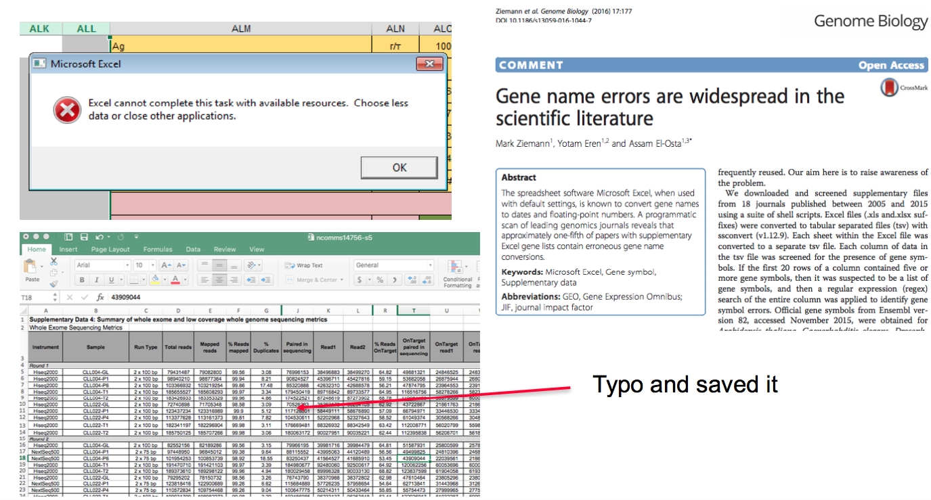
Why R? (as opposed to Excel?)

Slide 5
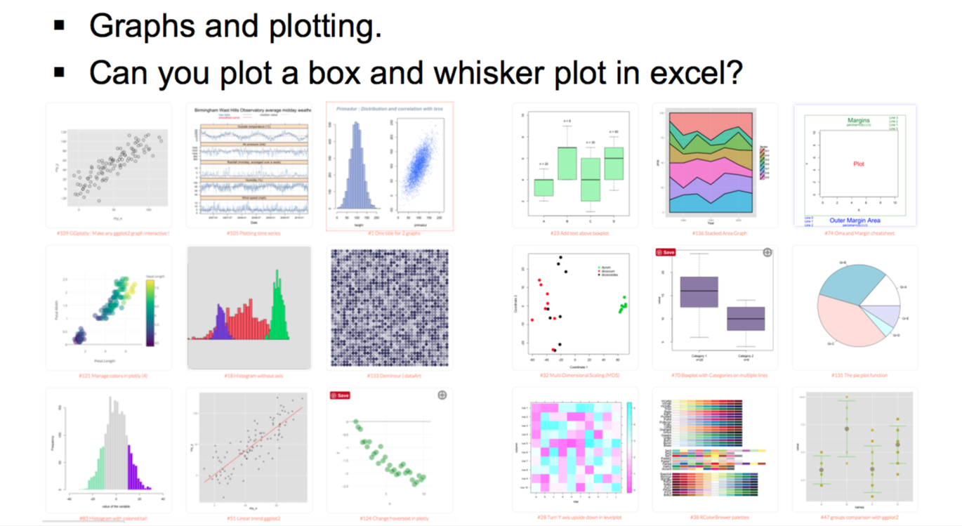
Why R? (as opposed to Excel?)

Slide 6
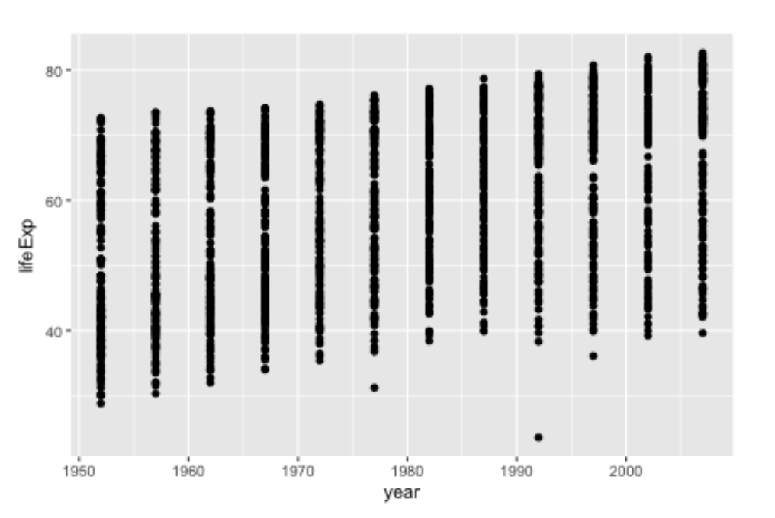
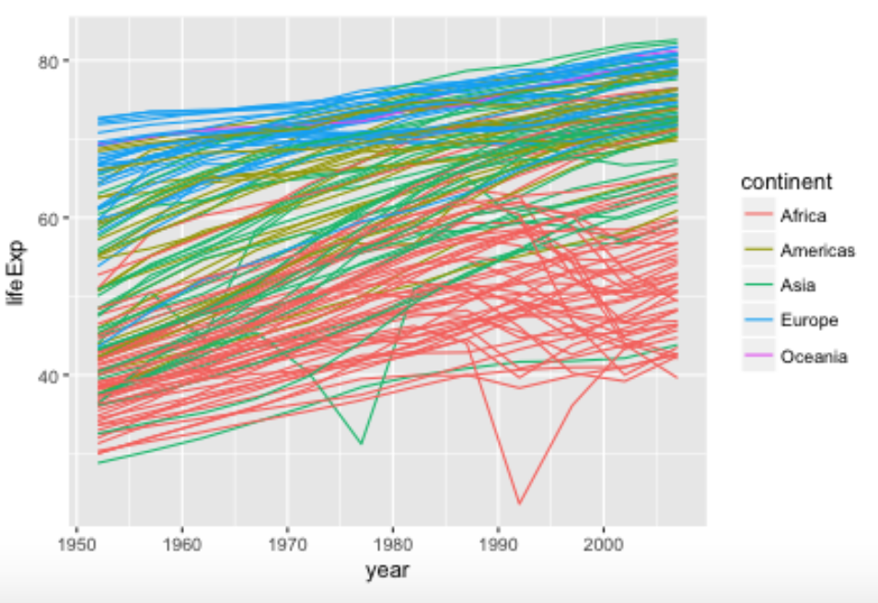
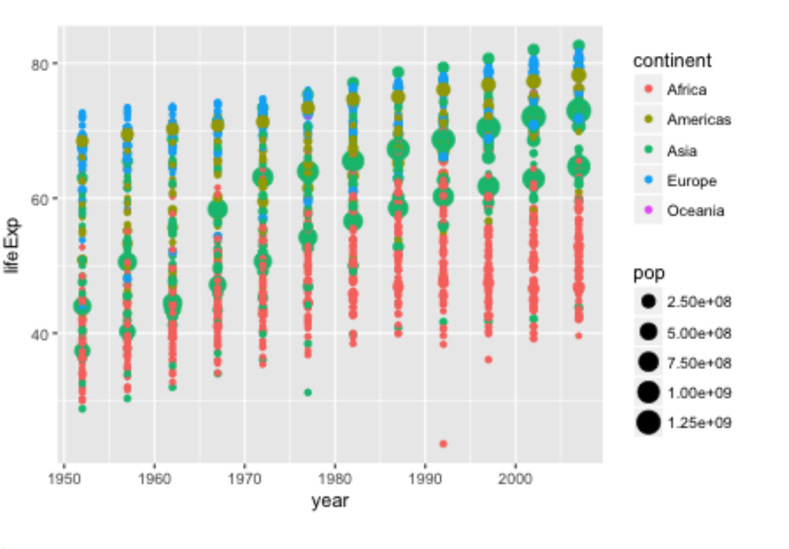
A better way to explore, present and interpret your data….
Learn to encode data
In a graph

Slide 7
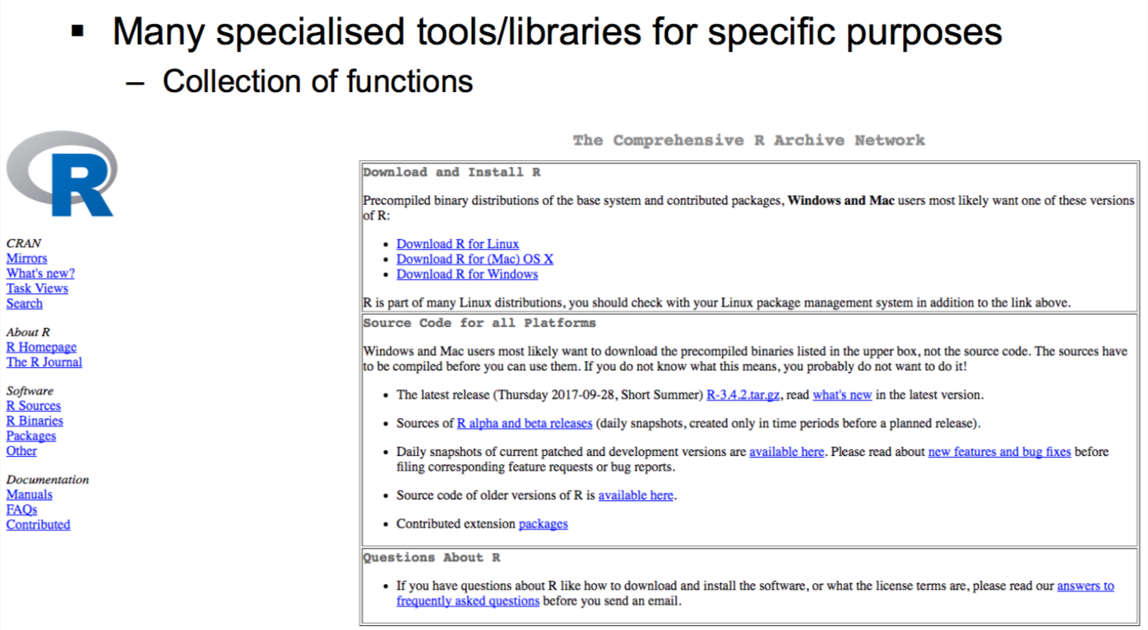
How to get R?
https://cran.r-project.org)

Slide 8
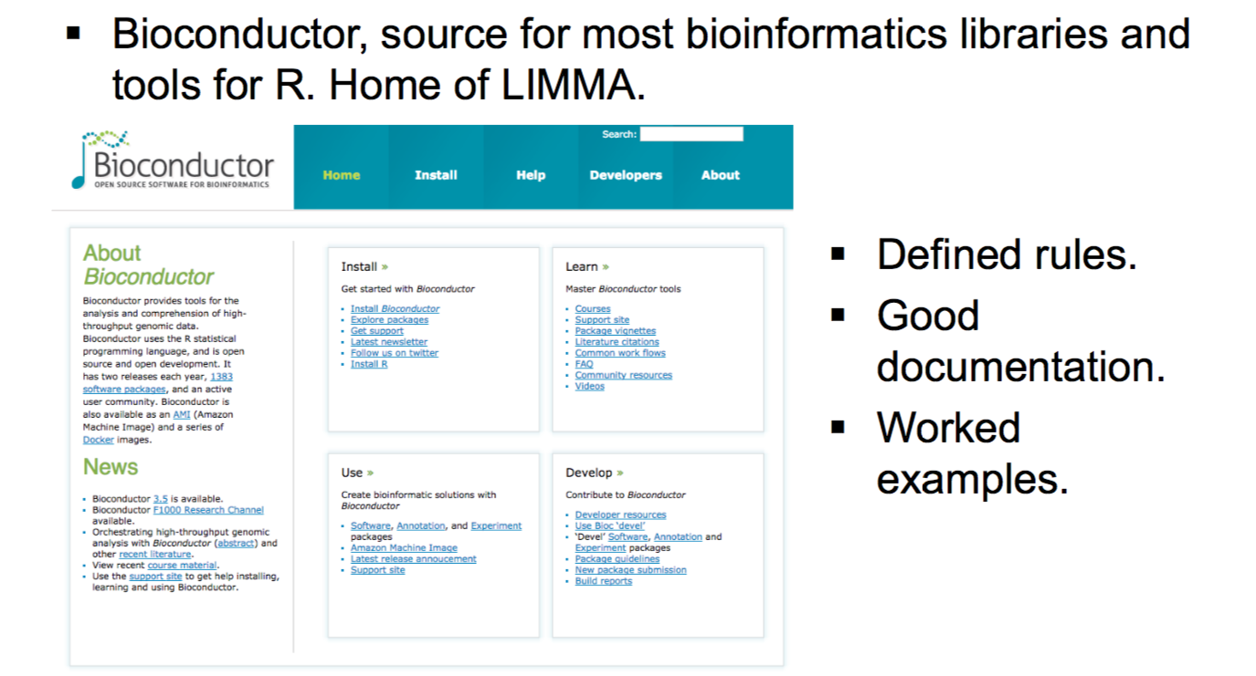
Tools and libraries used in R?

Slide 9
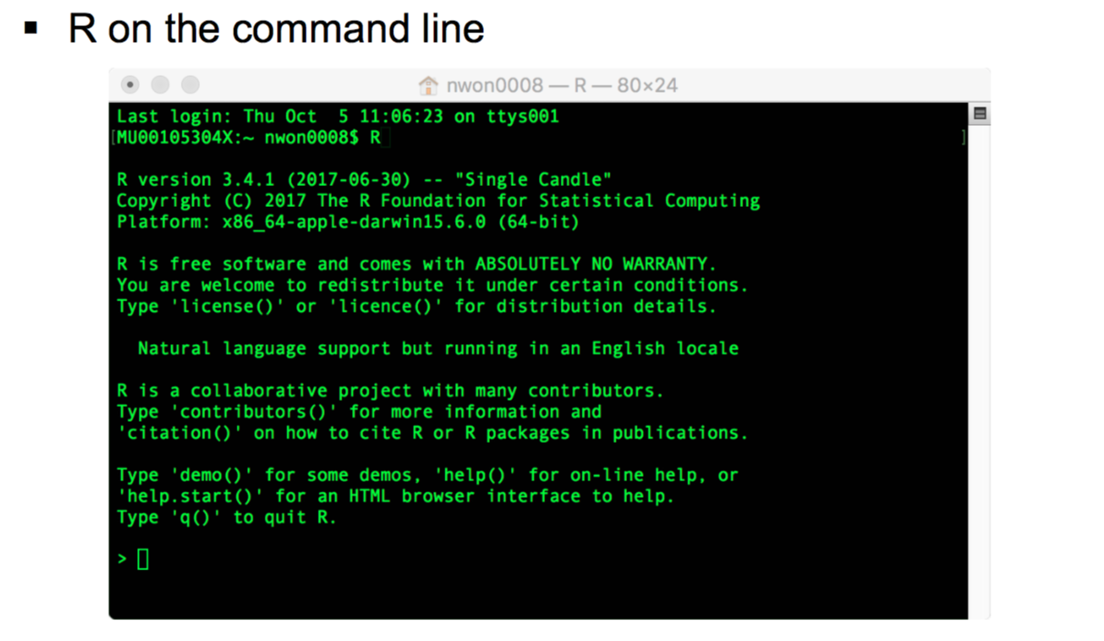
R and the interfaces to R

Slide 10
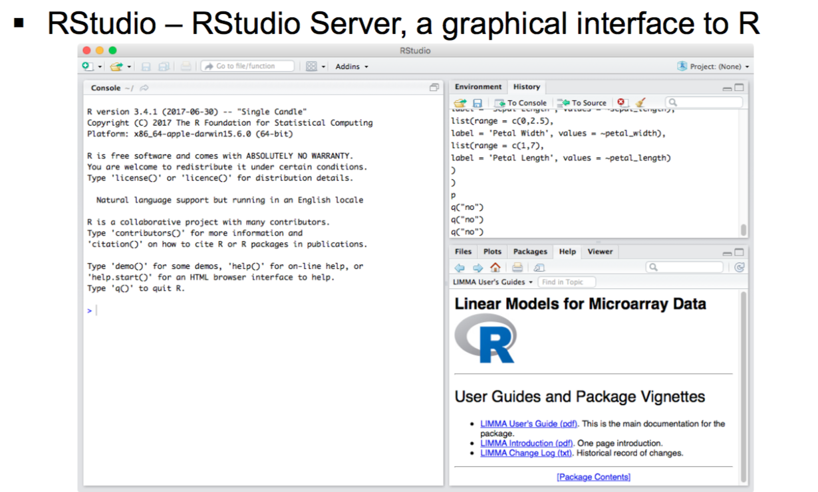
R and the interfaces to R
https://www.rstudio.com

Slide 11
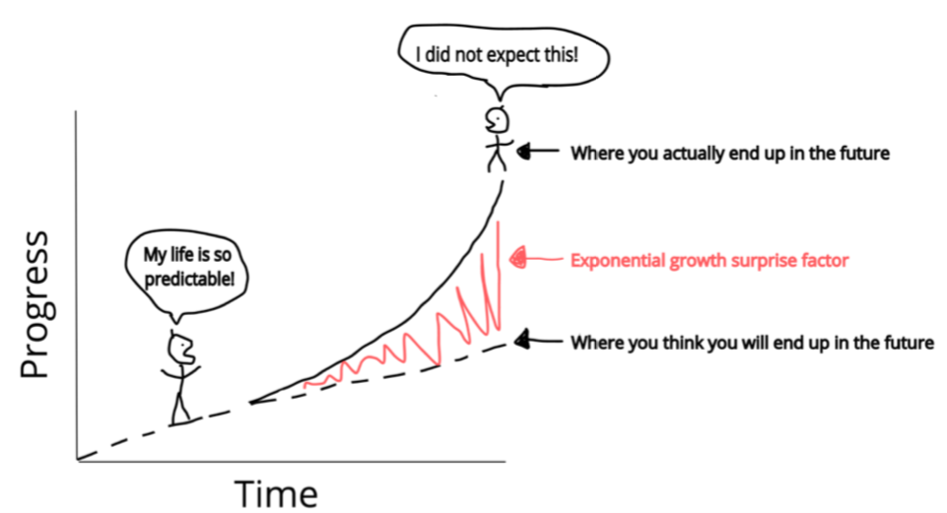
Today’s agenda
Starting out in R
Working with data in a matrix
Working with data frames
Plotting with ggplot2

Slide 12

What we won’t be covering but are important in the interest of time.
Things we won’t be covering but are of note:
Statistical modelling (lm, glm……).
Packages specific to bioinformatics. (RNA Seq)
Tidyverse and Tidyr (except ggplots)
Advanced R workshops

Slide 13
How today’s workshop works – signalling for help
Workshop notes
Sticky notes
I need help please
I am all good

Slide 14
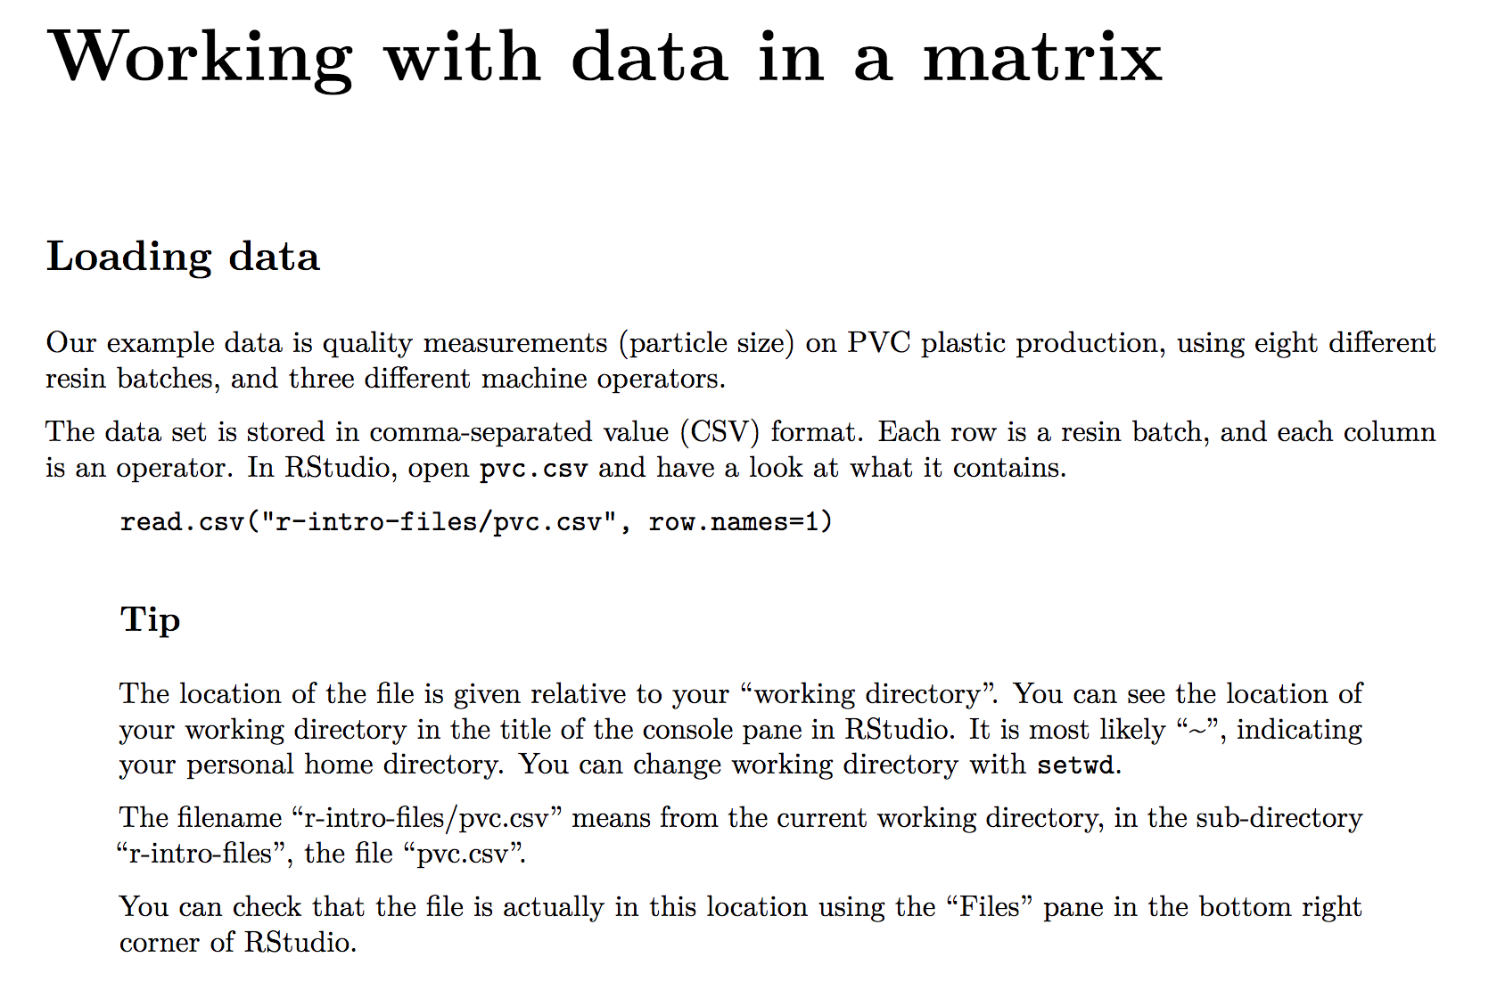
The R workbook
Explanatory text
The code

Slide 15
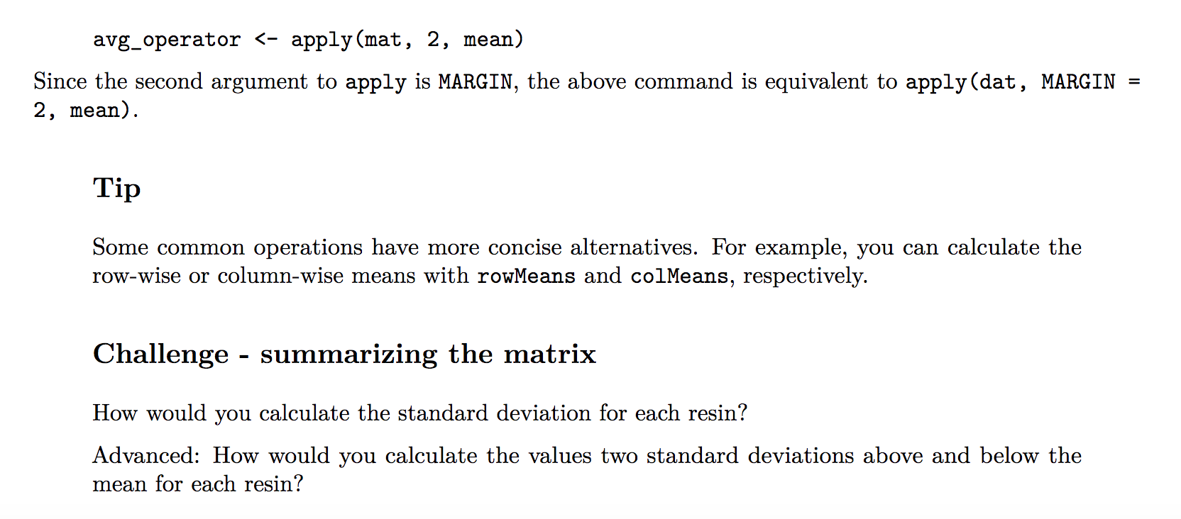
The R workbook – Challenges and extra homework
We will give you challenges through the workshop to work with the example data, also homework

Slide 16
Rounding up
This is the start of your R journey, many others are at the same stage, share your questions.
Attend this workshop again, and others we offer
Advanced R
Specialised use-cases with R (eg: RNASeq)
MBP have Friday help sessions at Clayton 3:30pm.
Alfred to be determined, contact Nick for questions.

Slide 17

Ice breaker activity
Introduce yourself to your neighbour(s) and tell them why you are here and what you want to achieve.

Slide 18
Basic concepts of R and take home messages
R is a programming language and your code can be recorded in an R script file.
Variable
Assignment operator <-
Functions name()
Subset [ x , y ]
Run code from R script command/control <enter>
Swap between panes control 1/2

